Slide 1
Managing Micronutrients with Soil (Plant) Testing and Fertilizer
Notes:
1

Slide 2
What Is Plant Analysis?
A tool to monitor or make decisions
Identify nutrient deficiencies and determine nutrient shortages
Determining the nutrient supplying capacity of the soil
Determining the effects of fertilizer application
Study relationships between fertility and plant/crop performance

Slide 3
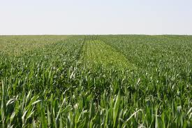
Analysis Tool
Analyze whole or specific plant parts for total mineral concentrations
What is sampled depends on crop type, stage and type of information you wish to gain

Slide 4
The When, Where and What
Corn
VE-V4
Whole plant
V5-V16
Upper most developed leaf
V17-R1
Leaf at the ear
R2-R6
Not Recommended

Slide 5
The When, Where and What
Soybean
Emergence to Pre-bloom
Whole plant
Bloom to R3
Most recently mature trifoliate
After R3
Not recommended

Slide 6
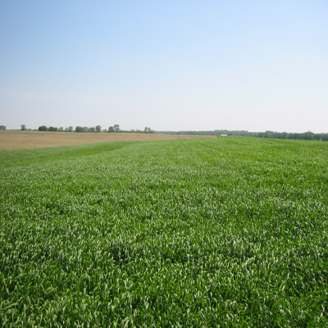
The When, Where and What
Wheat
Prefer the whole plant until heading
If taking flag leaf samples for N, must have 100+ flag leaves
After heading
Not recommended

Slide 7
Miscellaneous crops
Alfalfa
Top 1/3 of the plant
Grain sorghum/Milo
2nd collared leaf from the top
Pasture grasses
Whole plants
Anything else call and we can discuss what to sample
Dry beans, potatoes, oats, cotton, vegetable crops, trees, nut trees

Slide 8
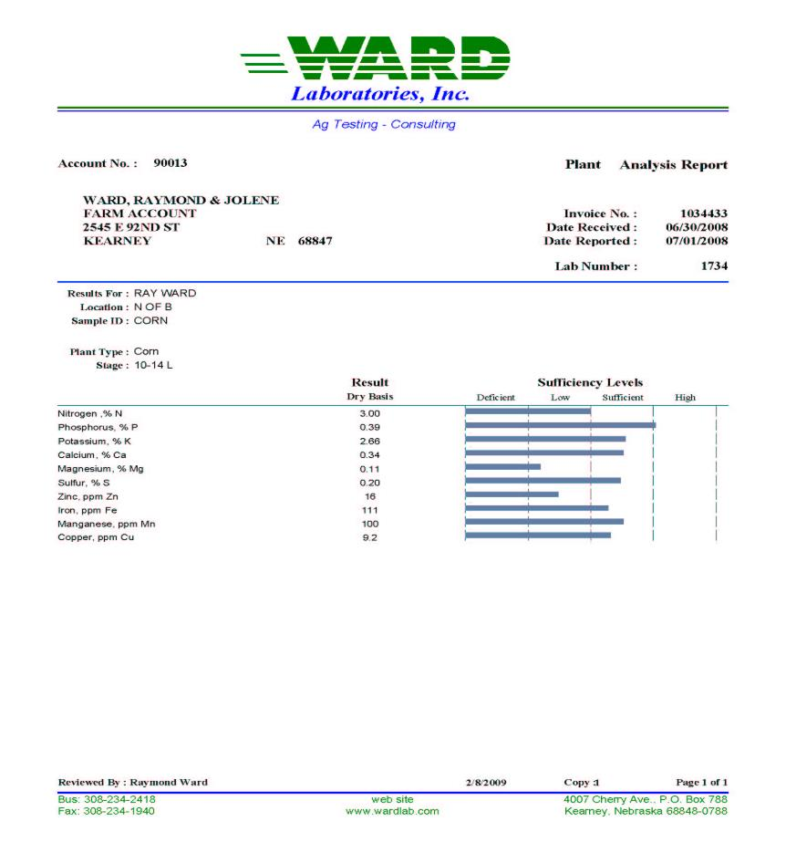
Corn 10-14 leaf stage

Slide 9
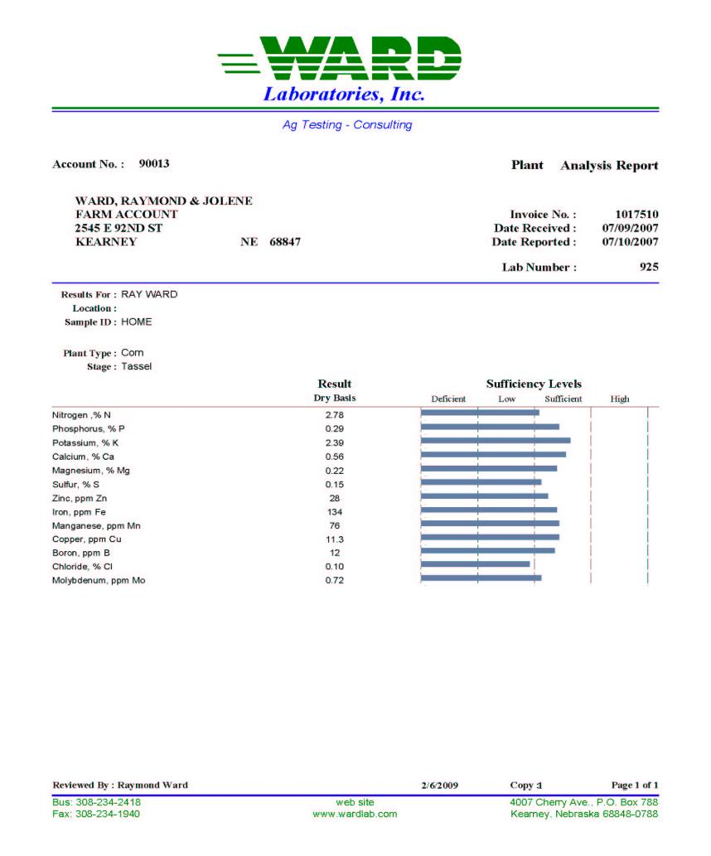
Corn at Tassel

Slide 10
Plant Analysis
Diagnose growth problems within a field
Slow crop growth
Poor color
Monitor nutrient level
Avoid hidden hunger

Slide 11
Deficiency Symptoms
Nitrogen
Older leaves turn light green to yellow color and spindly growth.
Phosphorus
Blue-green color, stiff, stunted and erect growth. Leaflets often fold together, and the undersides and stems may be red or purplish.
Potassium
Light green to yellow color and spindly growth.

Slide 12
Deficiency Symptoms
Magnesium
Older leaves turn yellow at the edge, similar to K
Sulfur
Sulfur Deficiency: Light green, similar to N deficiency, spindly stems and weak growth.

Slide 13
Deficiency Symptoms
Copper
Leaves are dark green, plant is stunted
Iron
Yellowing occurs between the veins of young leaves
Manganese
Yellowing pattern is not as distinct as with iron
Zinc
Shortened internodes, yellowing on mid-leaves across veins

Slide 14
Deficiency Symptoms
Boron
Terminal buds die, lower leaves misshapen, shortened internodes
Chloride
Wilting and reduced leaf growth
Molybdenum
Appear as N deficiency, stunted growth, and chlorosis

Slide 15
Plant Nitrogen
Corn Leaf Stage % N
3-5 3.5 – 5.0
6-9 3.2 – 4.8
10-14 3.0 – 4.0
15-18 2.8 – 3.5
Tassel 2.7 – 3.4

Slide 16
Plant Phosphorus
Corn Leaf Stage % P
3-5 .35 - .55
6-9 .28 - .38
10-14 .26 - .38
15-18 .26 - .37
Tassel .25 - .35

Slide 17
Plant Potassium
Corn Leaf Stage % K
3-5 2.5 – 3.5
6-9 2.3 – 3.5
10-14 2.2 – 3.0
15-18 2.1 – 2.6
Tassel 2.0 – 2.6

Slide 18
Plant Sulfur
Corn Stage % S
3-5 .20 - .28
6-9 .15 - .28
10-14 .15 - .26
15-18 .15 - .26
Tassel .15 - .26

Slide 19
Plant Ratios
Nitrogen:Sulfur Ratio
Ideal 12 to 15
Marginal 16-18
Deficient 19 and greater

Slide 20
Bob Miller (CSU) Ratio Study
Nitrogen:Magnesium Ratio
Less than 11 Greater than 11
------------Corn yield--------------
169.5 bu/A 202.5 bu/A

Slide 21
Bob Miller (CSU) Ratio Study
169.5 Bu/A 202.5 bu/A
%N 2.70 2.92
%K 1.65 2.04
N:K 1.76 1.44
%Mg .354 .219
Mg:K .217 .108

Slide 22
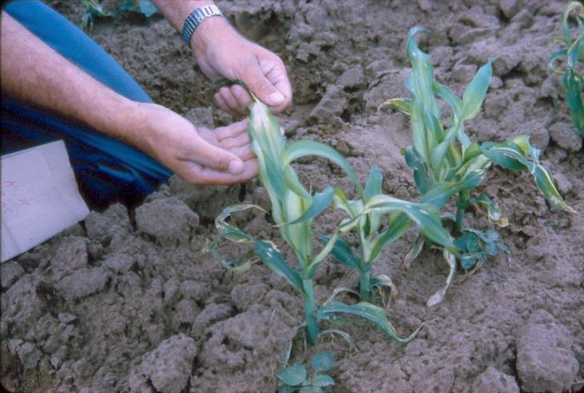
Zinc Deficiency

Slide 23
Plant Zinc
Corn Stage ppm Zn
3-9 Leaf 20 – 60
10-18 19 – 60
Tassel 18 – 60

Slide 24
Zinc Deficiency

Slide 25
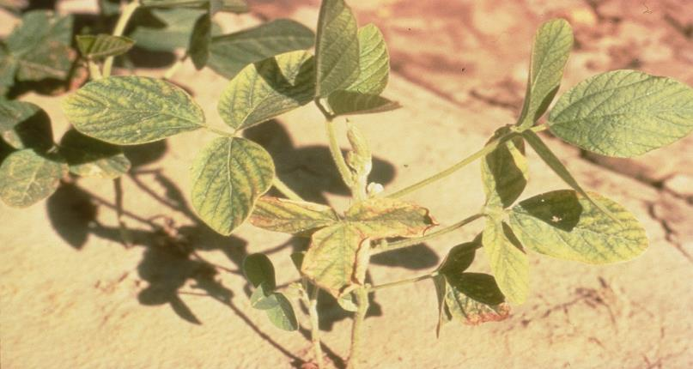
Zinc Deficiency

Slide 26
Zinc Soil (DTPA) Test and Recommendations
Corn Rate
Soil Test ppm Zn lb Zn/A
0-0.25 8-10
0.26-0.50 5-7
0.51-.75 3-4
0.76-1.00 1-2
1.01+ None
*Annual rate: Divide Corrective Rate by 6.

Slide 27
Iron Deficiency

Slide 28
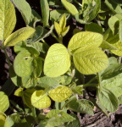
Iron Deficiency

Slide 29
Iron Chlorosis
Caused by calcareous soil condition
Bicarbonate precipitates iron in leaves so the plant cannot use the iron
Apply sulfate to reduce bicarbonate uptake by the plant

Slide 30
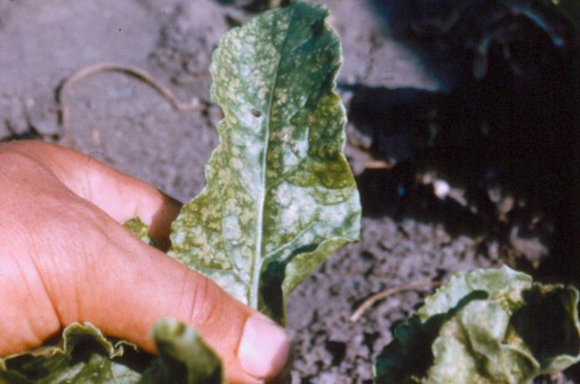
Manganese Deficiency

Slide 31
Plant Manganese
Corn Stage ppm Mn
3-14 Leaf 30 – 160
15-Tassel 20 - 150

Slide 32
Manganese Soil Test (DTPA) and Recommendations
Rate
Mn Soil Test, ppm Rating Lbs Mn/A
0-0.5 V Low 12
0.6-1.5 Low 7-12
1.6 – 3.0 Medium 1-6
3.1+ High 0

Slide 33
Plant Copper
Corn Stage ppm Cu
All leaf stages 5 - 20

Slide 34
Copper Soil Test (DTPA) and Recommendations
Cu Soil Test, ppm Rating Lbs Cu/A
0-0.10 V Low 3-6
0.11-0.20 Low 1-2
0.21-0.30 Medium 0
0.31-0.60 High* 0
0.61+ V High 0
* Specialty crops get Copper up to 0.60 ppm
** Corrective application rate

Slide 35
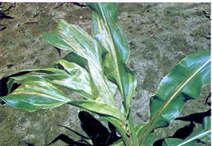
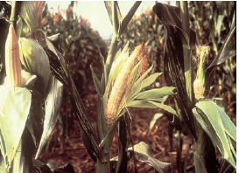
Boron Deficiency in Corn

Slide 36
Plant Boron
Corn Stage ppm B
3-18 leaf 5 – 25
Tassel 4 – 25

Slide 37
Boron Soil Test and Recommendations
Boron, ppm Rating Lbs B/A
0 – 0.25 Low 0.5 – 3.0
0.26 – 0.50 Medium 0.0 – 1.7
0.51 + High 0
Alfalfa, clover, peanuts, cotton and sugar beets require more boron than other crops.

Slide 38
Chloride Deficiency

Slide 39
Plant Chloride
Corn Stage % Cl
3-9 0.10 - 0.5
10-18 0.15 - 0.5
Tassel 0.18 - 0.5

Slide 40
Chloride Deficiency

Slide 41
Chloride Soil Tests and Cl Recommendations
Soil Test, ppm Cl lbs of Cl/A
< 4 ppm Cl 20 lbs/A
4 – 6 ppm Cl 10 lbs/A
> 6 ppm Cl 0 lbs/A
KSU based on average Cl in 0 - 24 inch soil root zone.

Slide 42
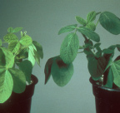
Molybdenum Deficiency

Slide 43
Molybdenum Application
Foliar Treatment
2 to 4 ounces of Moly Solution per acre in 20 gallons of water
Seed Treatment
0.5 ounce of sodium molybdate per 60 lbs of seed

